Slide 1
Sacred Trust
(part 2)
All verses are from the NKJV unless noted.

Slide 2
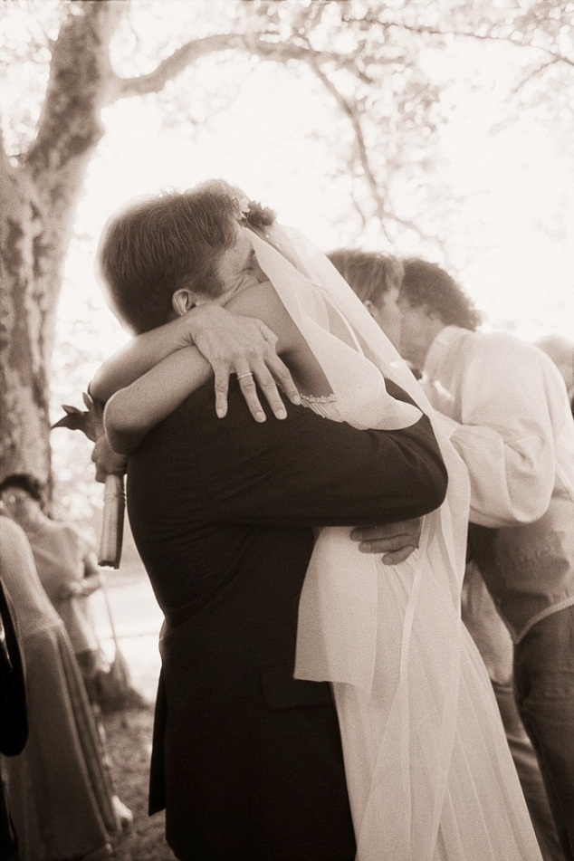
Marriage
“And the LORD God said, ‘It is not good that man should be alone; I will make him a helper comparable to him’” (Gen. 2:18)
Sacred Romance

Slide 3

Marriage
27 So God created man in His own image; in the image of God He created him; male and female He created them.
28 Then God blessed them, and God said to them, "Be fruitful and multiply; fill the earth and subdue it; have dominion over the fish of the sea, over the birds of the air, and over every living thing that moves on the earth" (Gen. 1:27, 28)
Sacred Romance
Male and female: God’s design and choice!
Chauvinism and feminism kick at God’s choice!
Notes:
When men abuse, belittle and despise women, they reflect their attitude toward God’s choices. When women reject men, they deny God’s choice. Because man and woman are made in God’s image, we should bridge the so-called gender gap with honor, not scorn.

Slide 4
Marriage
1 This is the book of the genealogy of Adam. In the day that God created man, He made him in the likeness of God.
2 He created them male and female, and blessed them and called them Mankind in the day they were created” (Gen. 5:1, 2)
Sacred Romance
Male and female: God’s design and choice!
Homosexuality = Perversion
Notes:
Homosexuality is NEVER marriage even if men and governments want to call it so. They call the murder of the unborn choice but that doesn’t change what it is in God’s mind. While marriage is honorable among all, homosexuality is condemned without reservation. Have you not read Genesis 19 and the account of Sodom and Gomorrah?
1 Corinthians 6:9, 10, “Do you not know that the unrighteous will not inherit the kingdom of God? Do not be deceived. Neither fornicators, nor idolaters, nor adulterers, nor homosexuals, nor sodomites,
10 nor thieves, nor covetous, nor drunkards, nor revilers, nor extortioners will inherit the kingdom of God.”

Slide 5
Marriage
27 So God created man in His own image; in the image of God He created him; male and female He created them.
28 Then God blessed them, and God said to them, "Be fruitful and multiply; fill the earth and subdue it; have dominion over the fish of the sea, over the birds of the air, and over every living thing that moves on the earth" (Gen. 1:27, 28)
Sacred Romance
Man is created and called to be higher than animals!

Slide 6
^{The} Sacred Romance
Qualities In
  Beneficial
  Understanding
  Joyful
  Spiritual
  Accountable
  Responsible
  Committed
  Cherishing
  Romantic
“It is not good that man should be alone; I will make him a helper comparable to him…So Adam gave names to all cattle, to the birds of the air, and to every beast of the field. But for Adam there was not found a helper comparable to him” (Gen. 2:18, 20)
Notes:
Woman is created comparable to man. She was made out of man and for man. She is a gift to man from God. Man is incomplete without her. Her fundamental purpose at creation was to become that help for man. When she works to undermine him, she denies her fundamental purpose of being created. The Jezebels and Delilahs of the world deny their God-given purpose and design.

Slide 7
^{The} Sacred Romance
Qualities In
  Beneficial
  Understanding
  Joyful
  Spiritual
  Accountable
  Responsible
  Committed
  Cherishing
  Romantic
“Husbands, likewise, dwell with them with understanding, giving honor to the wife, as to the weaker vessel, and as being heirs together of the grace of life, that your prayers may not be hindered” (1 Pet. 3:7)
Notes:
There should be an understanding quality in marriage. Man is called to recognize the wife and honor her. When she is a wife like 1 Pet. 3:1-6, how well or high should he honor and praise her? We cannot honor that which we do not understand. All that we honor we can understand. The woman in her role and work is an honorable position and the man, with understanding honors her.

Slide 8
^{The} Sacred Romance
Qualities In
  Beneficial
  Understanding
  Joyful
  Spiritual
  Accountable
  Responsible
  Committed
  Cherishing
  Romantic
“Husbands, likewise, dwell with them with understanding, giving honor to the wife, as to the weaker vessel, and as being heirs together of the grace of life, that your prayers may not be hindered” (1 Pet. 3:7)
Notes:
This speaks of together blissfulness. They together are partakers of the grace or favor of life.

Slide 9
^{The} Sacred Romance
Qualities In
  Beneficial
  Understanding
  Joyful
  Spiritual
  Accountable
  Responsible
  Committed
  Cherishing
  Romantic
“When a man has taken a new wife, he shall not go out to war or be charged with any business; he shall be free at home one year, and bring happiness to his wife whom he has taken” (Deut. 24:5)
Notes:
Even in the Old Law, God emphasized joy that should be brought and found in marriage. The man was to be discharged from certain duties to bring joy to his wife. Notice happiness is not just something that magically appears. It is to be brought to the home. He is to bring it to his wife. So we see that happiness here is a choice to embrace and also to take. Now is it only a year that happiness should be in the home?

Slide 10
^{The} Sacred Romance
Qualities In
  Beneficial
  Understanding
  Joyful
  Spiritual
  Accountable
  Responsible
  Committed
  Cherishing
  Romantic
“Live joyfully with the wife whom you love all the days of your vain life which He has given you under the sun, all your days of vanity; for that is your portion in life, and in the labor which you perform under the sun” (Eccl. 9:9)
Notes:
Live joyfully all the days of your life. Your marital joy can only be experienced in this life. It is a portion that God has given you “in life” under the sun. If joy is not in marriage, whose fault is it? One or both are not bringing joy to it. Happiness is a choice. You either decide to create it and embrace it or you don’t.

Slide 11
“Am I Happy?”
Many define their spouse by what he/she is not
Does not make marriage happier
The love-joy connection
  Joy often stems from love (Eccl. 9:9; Ps. 5:11; 1 Pet. 1:8; Gal. 5:22)
  Perhaps the better question is, “How can I love my spouse more?” (see Titus 2:4)
  “Where love is in the home there’s happiness, Where love is in the home there’s _______” (#308)
Notes:
He does do this. He will not do that. He cannot even see this. He never recognizes that. He does appreciate this. Etc., Etc.

Slide 12
^{The} Sacred Romance
Qualities In
  Beneficial
  Understanding
  Joyful
  Spiritual
  Accountable
  Responsible
  Committed
  Cherishing
  Romantic
“Husbands, likewise, dwell with them with understanding, giving honor to the wife, as to the weaker vessel, and as being heirs together of the grace of life, that your prayers may not be hindered” (1 Pet. 3:7)
Notes:
It is not commanded for these people to pray, it is assumed that they would be people of prayer. Because God created us in His image and likeness, we ought to have a desire to honor Him. Religion should be a family thing which makes the family honorable, joyful and beneficial. One of the reasons the American family is often seen as such an epic failure is not in its design or inception, but in its failure to have God govern it. Since God is the author of male and female and in particular, marriage, He should be welcomed into it by both the husband and wife. Think of it. How is it possible for husbands to love their own wives as Christ loved the church if they are ignorant of Christ and the church (Eph. 5:25).

Slide 13
^{The} Sacred Romance
Qualities In
  Beneficial
  Understanding
  Joyful
  Spiritual
  Accountable
  Responsible
  Committed
  Cherishing
  Romantic
“For the woman who has a husband is bound by the law to her husband as long as he lives. But if the husband dies, she is released from the law of her husband” (Rom. 7:2)
Notes:
Do you think animals hold animals accountable? Yet marriage is filled with responsibility and accountability. The woman here is shown to be bound by the law to her husband. She is therefore accountable to the law and therefore to the marriage. Now if the husband dies, she is released “from the law” that is concerning (NASB) her husband. If she is released from the law, she is no longer under it and no longer accountable to it.

Slide 14
^{The} Sacred Romance
Qualities In
  Beneficial
  Understanding
  Joyful
  Spiritual
  Accountable
  Responsible
  Committed
  Cherishing
  Romantic
“But if anyone does not provide for his own, and especially for those of his household, he has denied the faith and is worse than an unbeliever”(1 Tim. 5:8)

Slide 15
^{The} Sacred Romance
Qualities In
  Beneficial
  Understanding
  Joyful
  Spiritual
  Accountable
  Responsible
  Committed
  Cherishing
  Romantic
“For what you had before I came was little, and it has increased to a great amount; the LORD has blessed you since my coming. And now, when shall I also provide for my own house?” (Gen. 30:30)

Slide 16
^{The} Sacred Romance
Qualities In
  Beneficial
  Understanding
  Joyful
  Spiritual
  Accountable
  Responsible
  Committed
  Cherishing
  Romantic
“But I say to you that whoever divorces his wife for any reason except sexual immorality causes her to commit adultery; and whoever marries a woman who is divorced commits adultery” (Matt. 5:32)
Notes:
You are not free to just change your spouse in marriage. It was designed to be as permanent as your life here is. While you cannot change your spouse, you can change yourself to become a better person, better spouse, wife, husband, mother, father.

Slide 17
^{The} Sacred Romance
Qualities In
  Beneficial
  Understanding
  Joyful
  Spiritual
  Accountable
  Responsible
  Committed
  Cherishing
  Romantic
“So husbands ought to love their own wives as their own bodies; he who loves his wife loves himself. For no one ever hated his own flesh, but nourishes and cherishes it, just as the Lord does the church” (Eph. 5:28, 29)

Slide 18
^{The} Sacred Romance
Qualities In
  Beneficial
  Understanding
  Joyful
  Spiritual
  Accountable
  Responsible
  Committed
  Cherishing
  Romantic
“For this reason a man shall leave his father and mother and be joined to his wife, and the two shall become one flesh” (Eph. 5:31)

Slide 19
^{The} Sacred Romance
Qualities In
  Beneficial
  Understanding
  Joyful
  Spiritual
  Accountable
  Responsible
  Committed
  Cherishing
  Romantic
Sexual Morality & Endearment
1 Corinthians 7:1-5
Hebrews 13:4
Genesis 2:24; 24:67; 26:8
Proverbs 5:15-23
Song of Songs
“I charge you, O daughters of Jerusalem, By the gazelles or by the does of the field, Do not stir up nor awaken love Until it pleases”
(Song. 2:7)
Notes:
All of these are components of marriage and when any of these are lacking, the marriage suffers.

Slide 20
Does Marriage Help Holiness?

Slide 21
Yes!
It is a help to avoid sexual immorality (1 Cor. 7:2)
It is “like Christ”
  “Husbands, love your wives, just as Christ also loved the church and gave Himself for her” (Eph. 5:25)
It promotes prayer
  Concern base grows  prayers grow with it
  Men leading in prayer (1 Tim. 2:8)
It props up a mirror
Notes:
MIRROR: Someone once said, “One of the best wedding gifts God gave you was a full-length mirror called your spouse. Had there been a card attached, it would have said, ‘Here’s to helping you discover what you’re really like’.” We can often see our weaknesses by our spouse or perhaps even in our spouse. Jezebel was a testimony to the character of Ahab. Likewise, the church, as the spouse of Christ is to reflect the person of Christ (Eph. 5:25-27). The glorious church reflects the glory of Christ. The presence of holiness and the absence of blemish can only reflect the nature of Jesus. But also, a man who beats his wife shows his character too. That he has hates himself and has no self-control (Eph. 5:28, 29). A domineering wife reflects a weak hen pecked husband. Wives, like it or not, you are representing your husband by how you are. In marriage you not only find out things about your spouse, but you find out things about yourself. In disagreements you can see how your character really is. You can see how small, hard and unforgiving you are. Marriage is a mirror! Someone said, “Couples don’t fall out of love so much as they fall out of repentance. Sin, wrong attitudes, and personal failures that are not dealt with slowly erode the relationships.” So marriage is a purifying institution. Have you ever thought of it that way? That is what we see with Christ and the church (Eph. 5:26). But we often do not want marriage to reveal our own weakness. We suppress it and if it is revealed, we begin to resent our spouse.

Slide 22
Your Marriage Is A Sacred Trust
"So then, they are no longer two but one flesh. Therefore what God has joined together, let not man separate"
(Matt. 19:6)
1) Pour your self into it

Slide 23
Your Marriage Is A Sacred Trust
"So then, they are no longer two but one flesh. Therefore what God has joined together, let not man separate"
(Matt. 19:6)
2) Protect it from foes
  Predators (Prov. 6:24-29; 7:1-27; 25:17)
  Past relationships
    “If only I had married so and so...”
    “I wonder what he/she is doing now?”
    Employ principle of 2 Corinthians 5:17; Philippians 3:13
Notes:
Sometimes married couples may later spend time thinking about their previous time before they were married and the various people they dated. Some may feel guilt for breaking off that relationship and want to look them up again. You need to be putting your energies into your marriage, that is what God wants you to do. Some may live in a fantasy land of what it would have been like if they married a previous boyfriend or girlfriend. They may even fantasize what would it would be like if their spouse had died and they married them. That is also a dead-end road which is unbiblical, destructive and self-defeating. It hasn’t happened; it didn’t happen so put it away. It is easy to think of how happy another relationship would be because we are a people who like to have selective memories. We remember only what we want to and think only what we want to about certain people. We forget the negative things about them and emphasize only the positive fantasies that we have created. God calls us to desist from such warped thinking and love our spouse more than anyone else could. We need to live by the principle of 2 Corinthians 5:17 and Philippians 3:13.

Slide 24
Your Marriage Is A Sacred Trust
"So then, they are no longer two but one flesh. Therefore what God has joined together, let not man separate"
(Matt. 19:6)
3) Preserve it with the fear of the Lord
  Proverbs 3:5-8; Deut. 9:19; Acts 5:11; 9:31
  If you are married to a Christian, you are married to God’s son or daughter!
    “I will be a Father to you, And you shall be My sons and daughters, Says the LORD Almighty” (2 Cor. 6:18)
  How happy do you think your heavenly Father is with the way you love His son/daughter
Notes:
If you are married to a Christian, you are not married to an orphan! God sees every act, he can hear every word and read every thought. Is he happy with you and with me? Is He smiling or storing up, that is, does God smile the way I love my spouse, or is He storing up wrath on my account for the way I treat her? When we look at our marriages through this filter, it becomes very sobering. I need to love my wife the way the Bible tells me because her father is God. So even if I am 1000 miles away from her, God sees in my hotel room and while I am gone, He sees inside my house. The fear of the Lord is the prescription for rebellion. If I do not have a healthy dose of fear, I will rebel. So, while beauty perishes, the fear of the Lord remains and every healthy marriage will have a healthy dose of fear in it.

